Slide 1
MULTIPLE
REGRESSION USING MATRICES
• Multiple Regression
• Matrix Formulation of Regression
• Applications to Regression Analysis

Slide 2

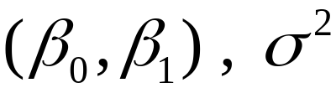
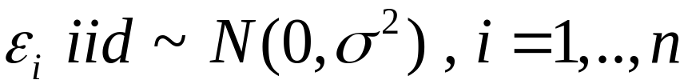
SIMPLE LINEAR MODEL
• Data:
• Parameters:
• Model:

Slide 3





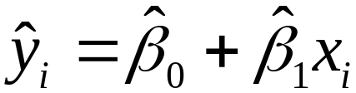

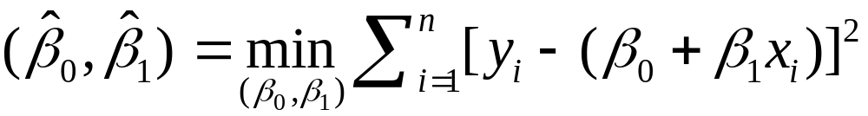
SIMPLE REGRESSION ESTIMATION
• Estimate Conditional Mean:
Line of Best Fit
•
• Data Points:
•
• Predicted Value:
•
where:

Slide 4

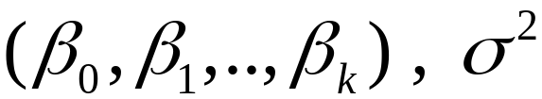
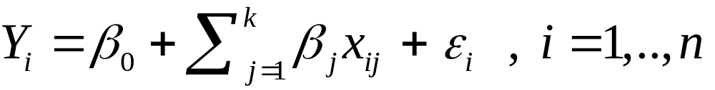
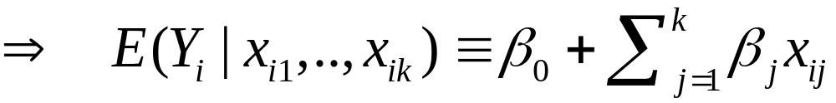
STANDARD LINEAR MODEL
• Data:
• Parameters:
• Model:

Slide 5

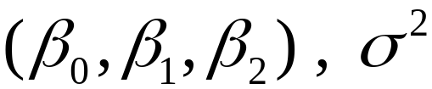
STANDARD LINEAR MODEL (k = 2)
• Data:
• Parameters:
• Model:

Slide 6

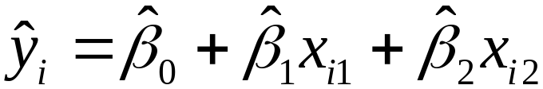



REGRESSION ESTIMATION (for k =2)
• Data Points:
Plane of Best Fit
•
• Predicted Value:
•
where:
•

Slide 7
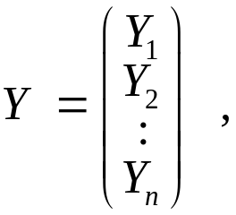
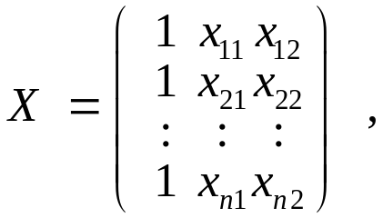
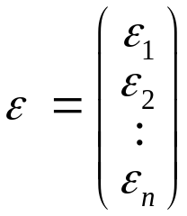
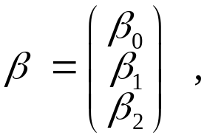

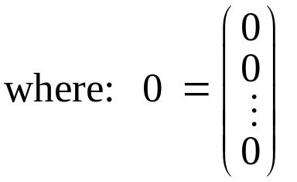
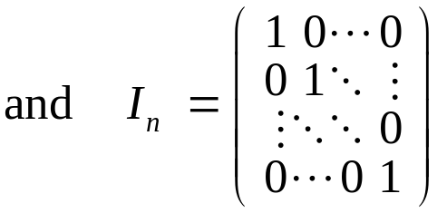
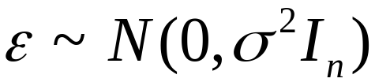
MATRIX REPRESENTATION OF
THE STANDARD LINEAR MODEL
• Vectors and Matrices:
• Matrix Reformulation of the Model:

Slide 8








LINEAR TRANSFORMATIONS
IN ONE DIMENSION
• Linear Function:
• Graphic Depiction:
•
•
•
•
•

Slide 9
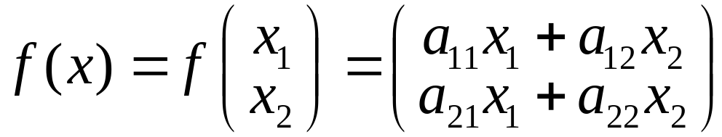
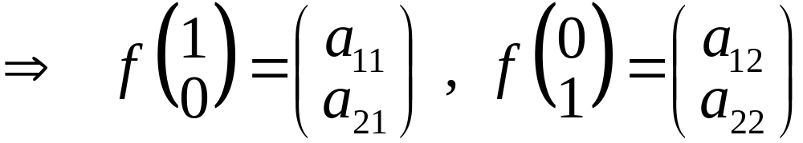
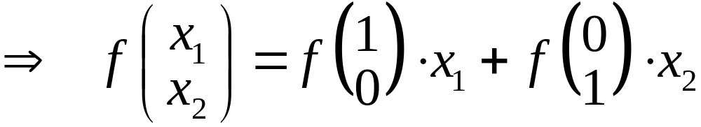
LINEAR TRANSFORMATIONS
IN TWO DIMENSIONS
• Linear Transformation:

Slide 10

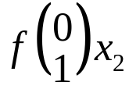
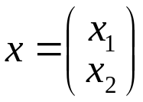
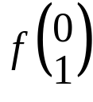
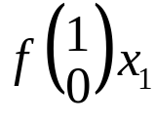

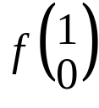

• Graphical Depiction of Linear Transformation:
•
•
•
•
•
•
•
•

Slide 11
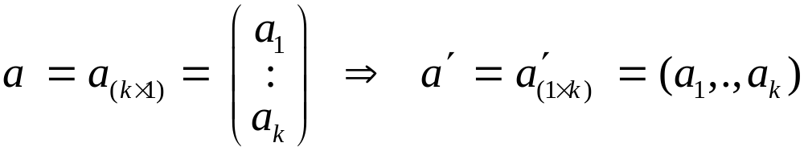
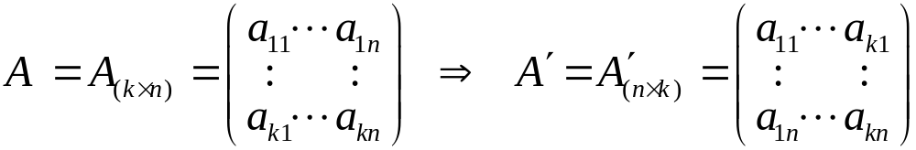


SOME MATRIX CONVENTIONS
• Transposes of Vectors and Matrices:
• Symmetric (Square) Matrices:
• Important Example:

Slide 12
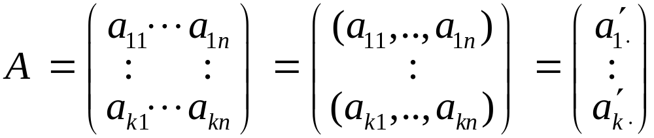
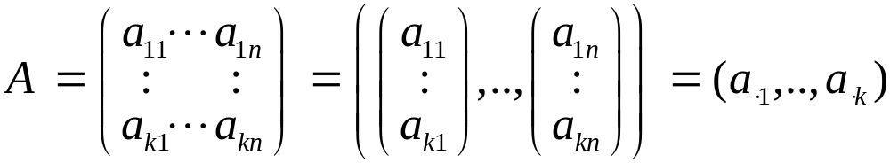
• Row Representation of Matrices:
• Column Representation of Matrices:

Slide 13
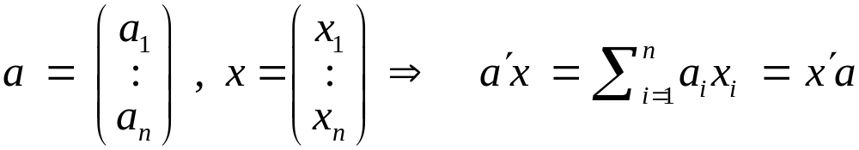
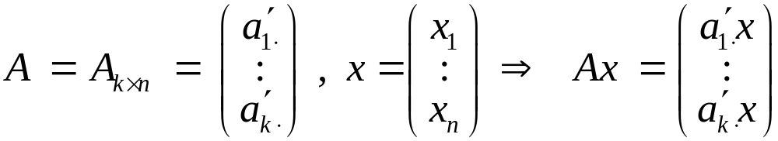
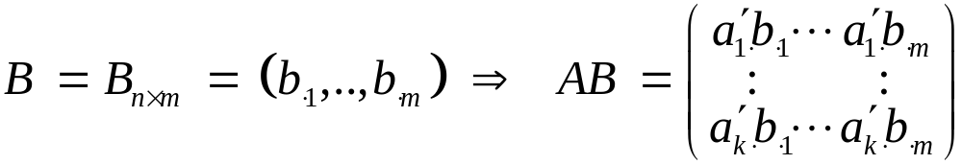

• Inner Product of Vectors:
• Matrix Multiplication:
• Transposes:

Slide 14
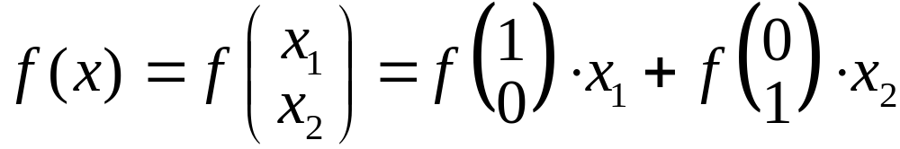
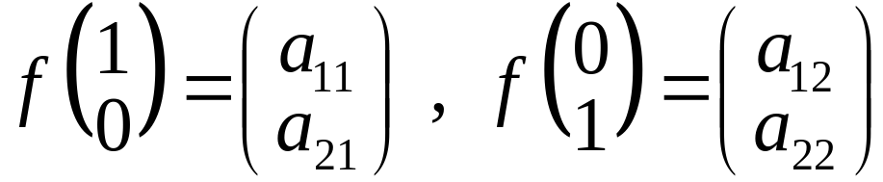
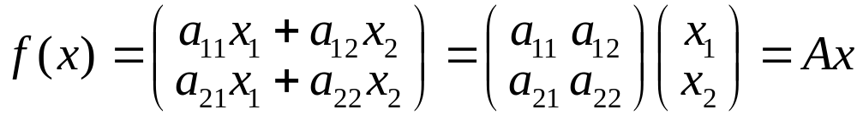
MATRIX REPRESENTATIONS OF LINEAR TRANSFORMATIONS
• For any Two-Dimensional Linear Transformation :
with :

Slide 15

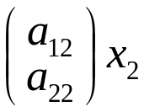
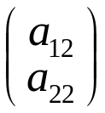
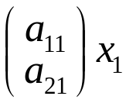
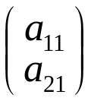
• Graphical Depiction of Matrix Representation:
•
•
•
•
•
•
•
•

Slide 16
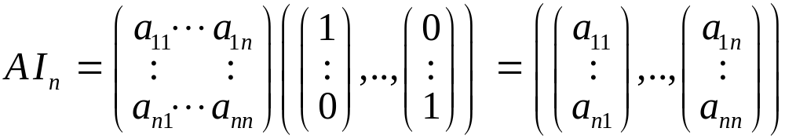
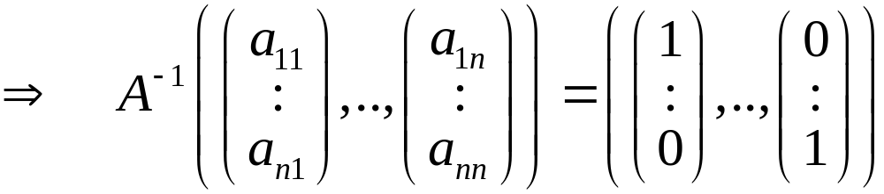
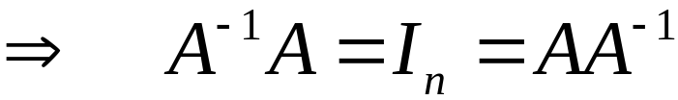
• Inversion of Square Matrices (as Linear Transformations):

Slide 17
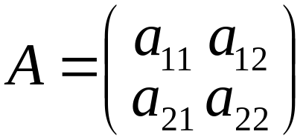



DETERMINANTS OF SQUARE MATRICES
•
•
•
•
•
•

Slide 18

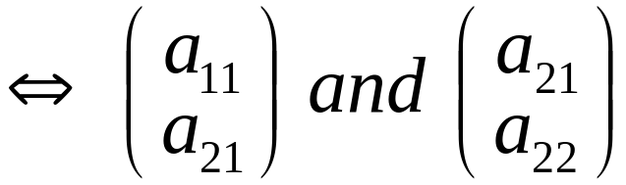

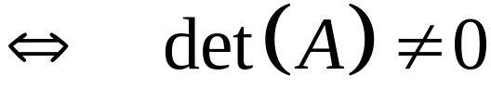

NONSINGULAR SQUARE MATRICES
•
•
•
•
•
•

Slide 19
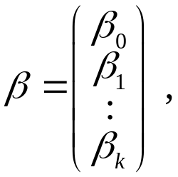
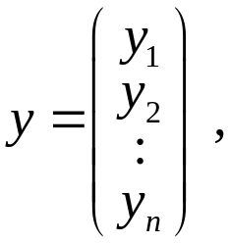
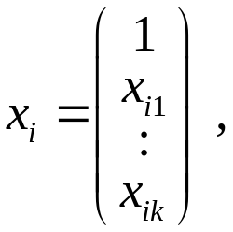
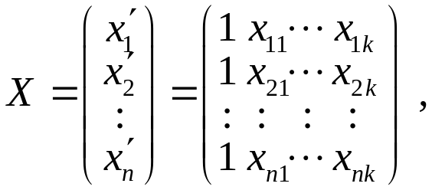
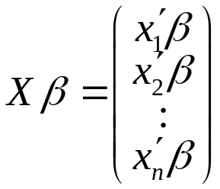

LEAST-SQUARES ESTIMATION
• General Regression Matrices:
• General Sum-of-Squares:

Slide 20
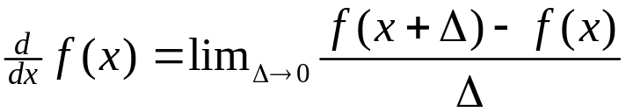










DIFFERENTIATION OF FUNCTIONS
• General Derivative:
•
• Example:
•
•

Slide 21






PARTIAL DERIVATIVES
•
•

Slide 22



VECTOR DERIVATIVES
• Derivative Notation for:
• Gradient Vector:

Slide 23






TWO IMPORTANT EXAMPLES
• Linear Functions:
• Quadratic Functions:

Slide 24




• Quadratic Derivatives:
• Symmetric Case:

Slide 25






MINIMIZATION OF FUNCTIONS
• First-Order Condition:
• Example:
•
•

Slide 26







TWO-DIMENSIONAL MINIMIZATION
•
•
•

Slide 27





LEAST SQUARES ESTIMATION
• Solution for:

Slide 28



NON-MATRIX VERSION (k = 2)
• Data:
• Beta Estimates:

